Slide 1
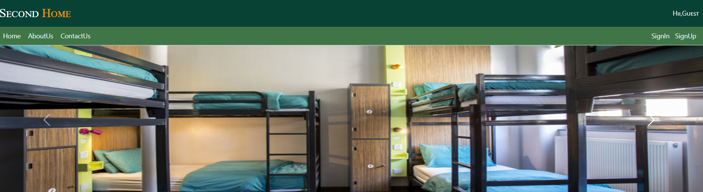
Second Home Web App

Slide 2

IACSD

Slide 3
Introduction
This system is designed in favor of the hostel management which helps them to save the records of the students about their rooms and other things. It helps them from the manual work from which it is very difficult to find the record of the students and the mess bills of the students, and the information of about the those ones who had left the hostel. All the hostels at present are managed manually by the hostel office. The Registration form verification to the different data processing is done manually. Thus there are a lot of repetitions which can be easily avoided.

Slide 4
Admin Features
Create , Update, Manage, Delete User
Creating Offer Plan
Manage Billing
Manage User Enquiry through Email
Manage Owner Info

Slide 5
Purpose
This software product the hostel management to improve their services for all the students of the hostel. This also reduce the manual work of the persons in admin penal and the bundle of registers that were search when to find the information of a previous student, because through this system you can store the data of those students who had left the hostel . Through this you can check the personal profile of all the current students within few minutes the data base of the system will help you to check a particular one. The system will help you to check the mess bills of every student and the student’s hostel dues. The students of the hostel will be recognized from the ID number allocated at the room rental time. In the last this system will improve the management work in the hostel.

Slide 6
Project Scope
The project has a wide scope, as it is not intended to a particular organization. This project is going to develop generic software, which can be applied by any business organisation . Moreover it provide facility to its users. Also the software is going to provide a huge amount of summary data.

Slide 7
Proposed System
The development of new system contains the following activities,which try to automate the entire process keeping in view of the database the integration approach.
User friendliness is provided in the application with various controls.
The System makes the overall project management much easier and flexible.
There is no risk of data mismanagement at any level while the project development is under process.
It provides high level of security with different level of authentication.

Slide 8
Software Used
IDE STS(SPRING TOOL SUITE)
Chrome or MicrosoftEdge

Slide 9
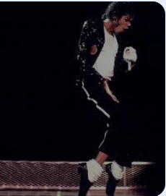
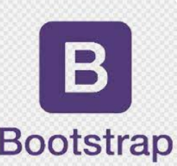
Front End(Language Used)
Web Designing
JSP( fuctionality) Bootstrap

Slide 10


Back End Technologies Used
JAVA
MYSQL

Slide 11
System Design
Unified Modeling Language:
UML stands for Unified Modeling Language. It is a third generation method for specifying,visualizing and documenting the artifacts of an object oriented system under development. Object Modeling is the process by which the logical objects objects in real world(problem space) are representing

Slide 12
Application Design
Spring Boot with Rest API
Spring Boot:Spring Boot is an open-source Java-based tool used to create Web Applications and Microservices with ease.
REST:Representational State Transfer, also known as REST, is basically a standardized Software Architecture Style, or in simple words, a specific type of API used by the industry to establish a connection between Client and Server.
API:An Application Programming Interface (API) establishes a connection between computers or between computer programs (applications) by providing readily available codes and information pipelines. It is a type of software interface that acts as a mediator among other pieces of software to streamline the interaction with one other.

Slide 13
The Unified Modeling Language encompasses number of models Use case diagrams Class diagrams Sequence diagrams

Slide 14
Use Case Diagram:
Use Case Diagram consists of use cases,actors and shows the interaction between them.The key points are:
The main purpose is to show the interaction between the use cases and the actor.
To represent the system requirement from user’s perspective .
The use cases are the functions that are to be performed in the module.
An actor could be the end user of system or an external system

Slide 15
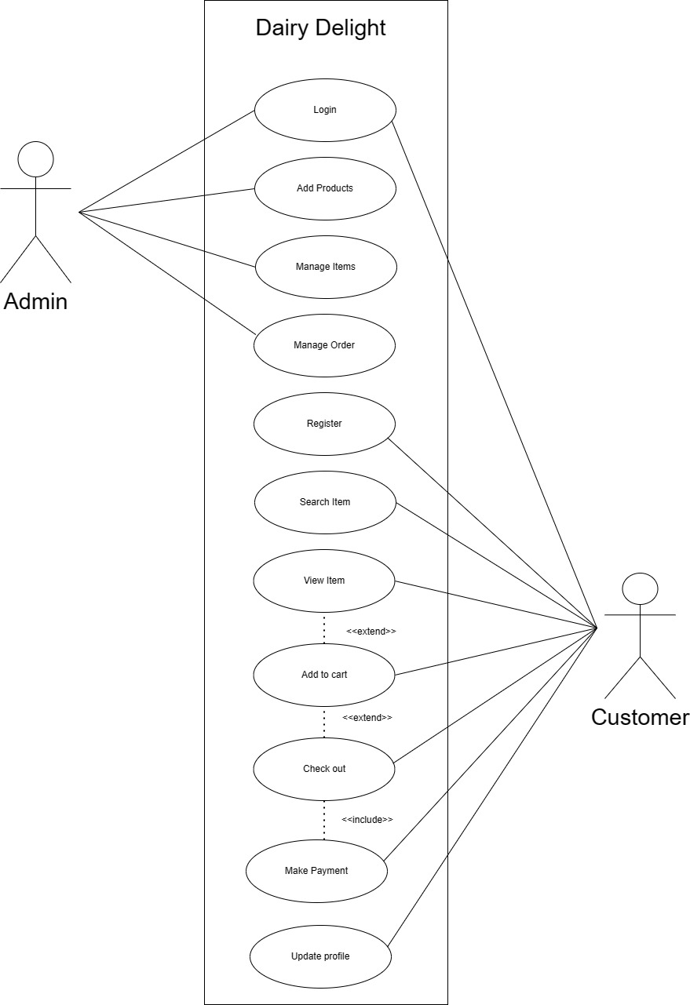
Use Case Diagram

Slide 16
Sequence Diagram:
The Purpose of sequence diagram is to show the flow of functionality through a use case. In other words, we call it a mapping process in terms of data transfers from the actor through the corresponding objects.

Slide 17
Sequence Diagram

Slide 19
Class Diagram

Slide 20
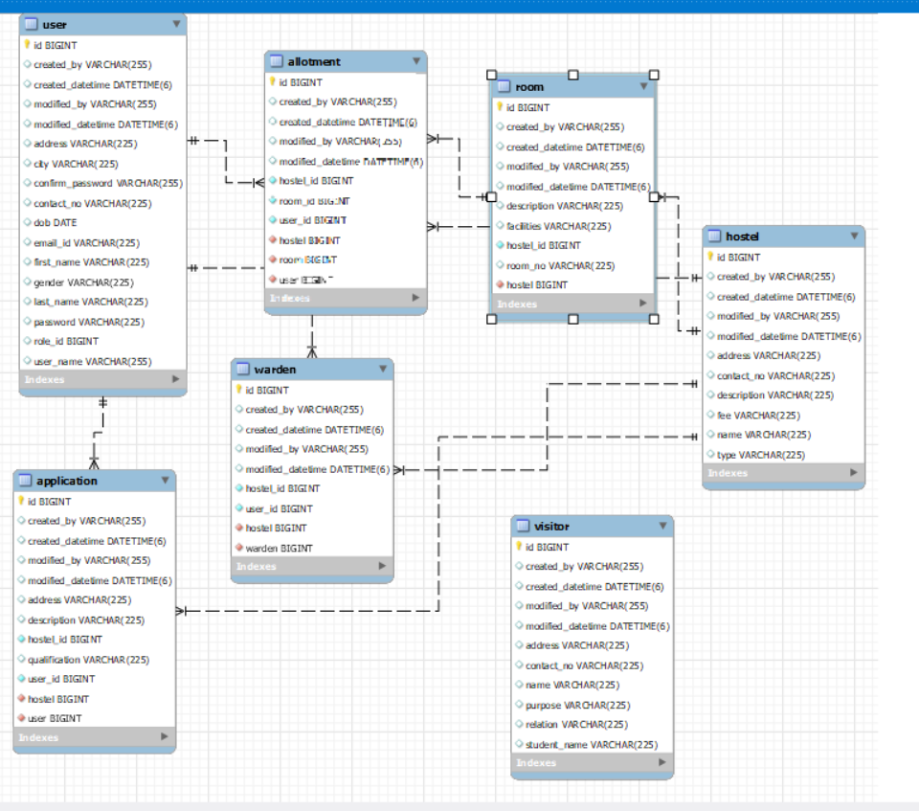

Slide 21
SCREENSHOTS

Slide 22
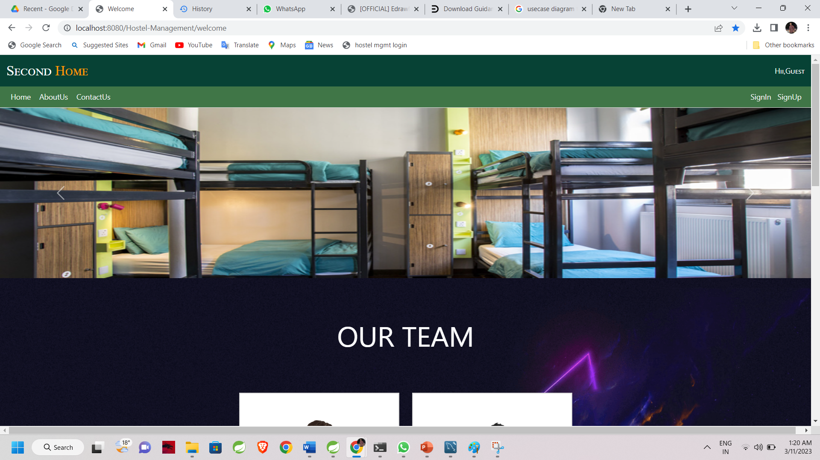

Slide 23
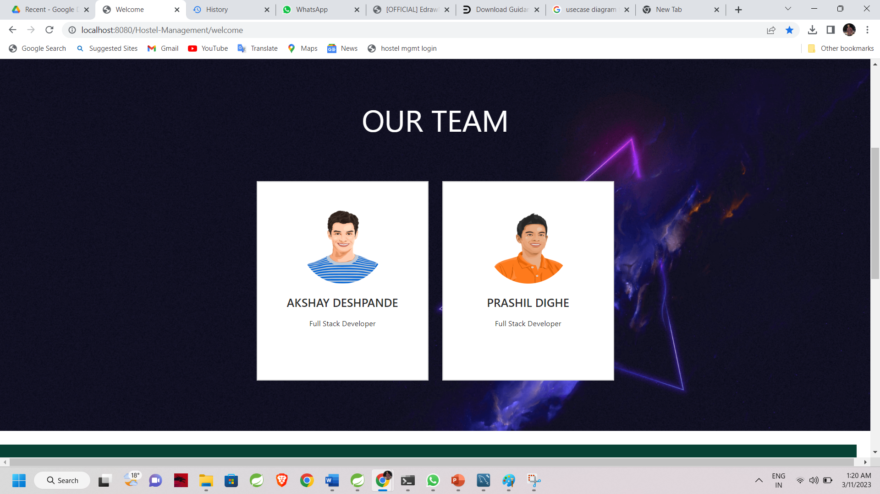

Slide 24
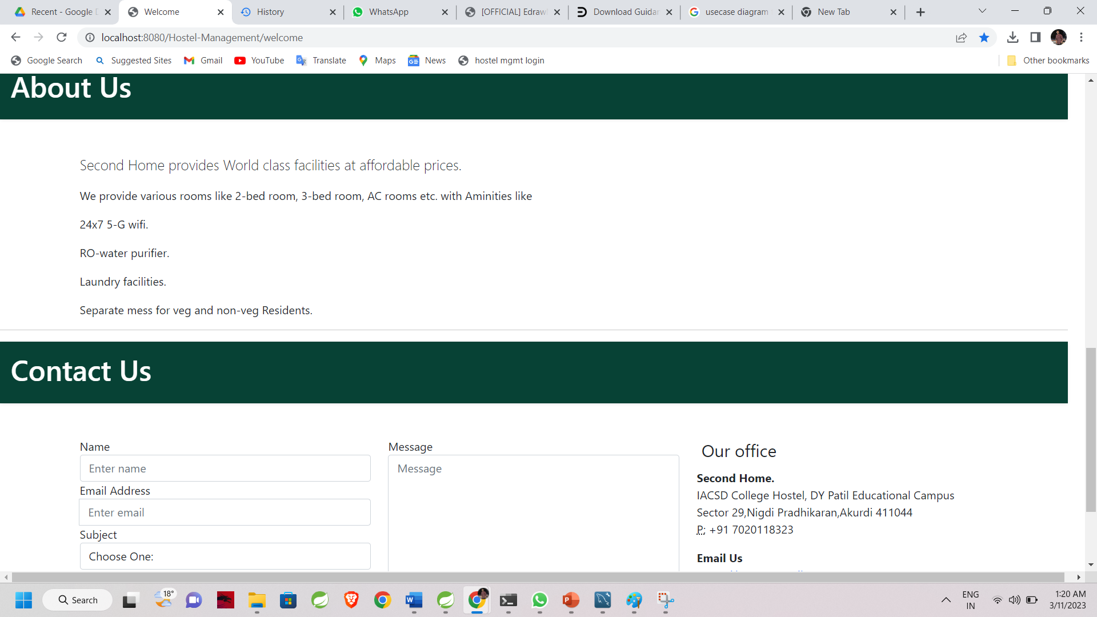

Slide 25
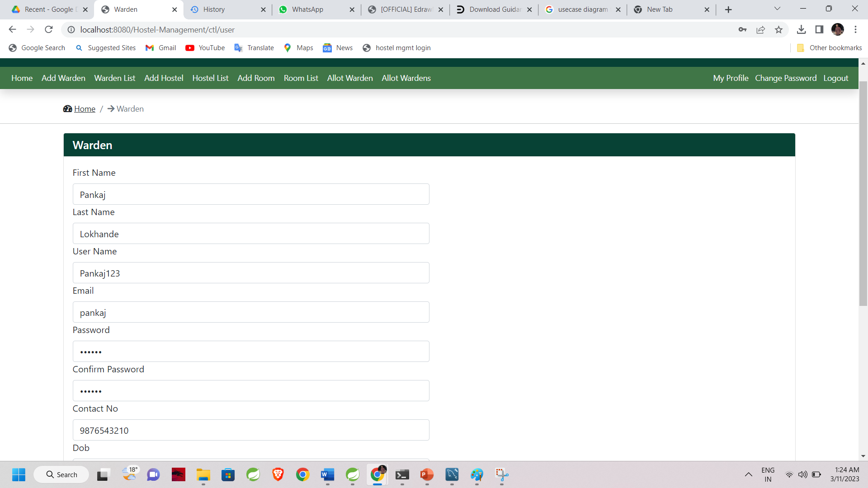

Slide 26
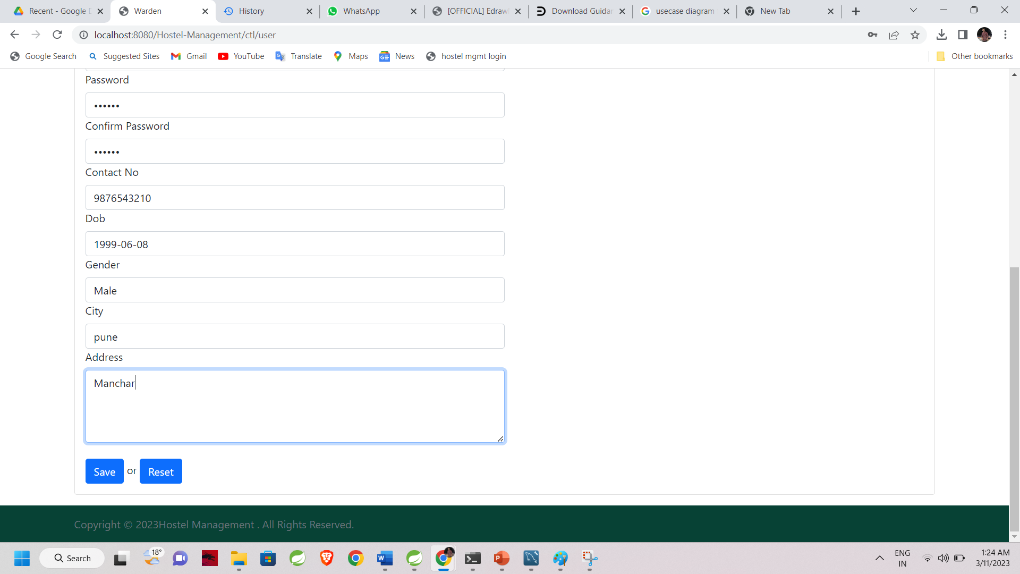

Slide 27
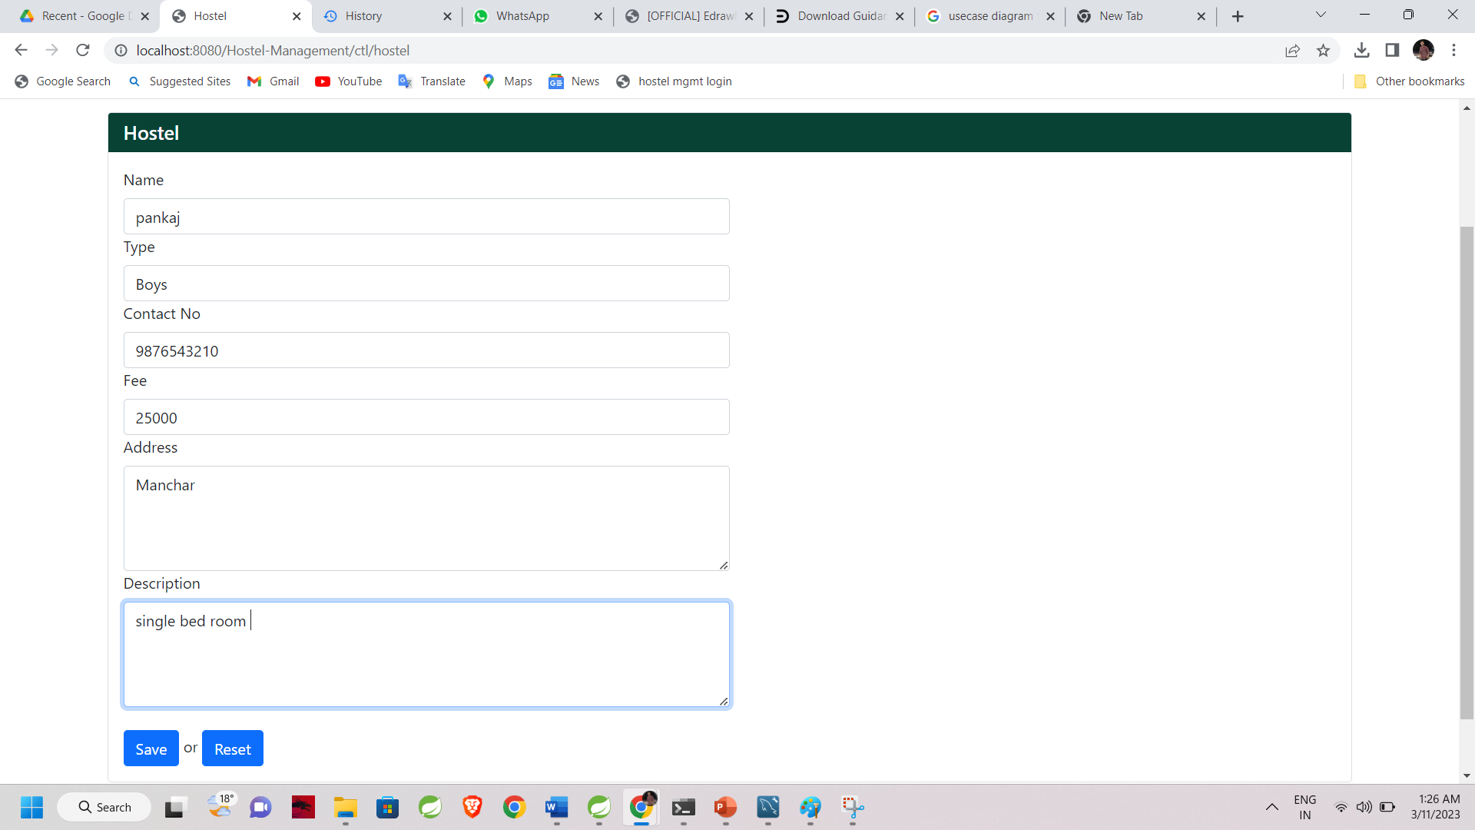

Slide 28
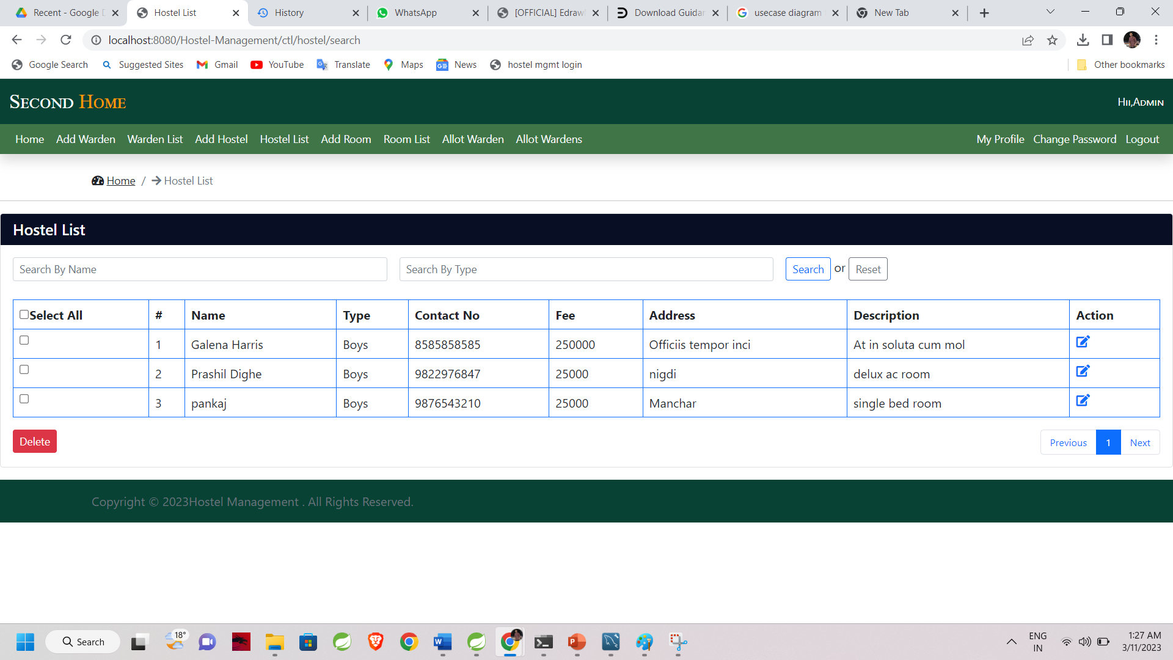

Slide 29
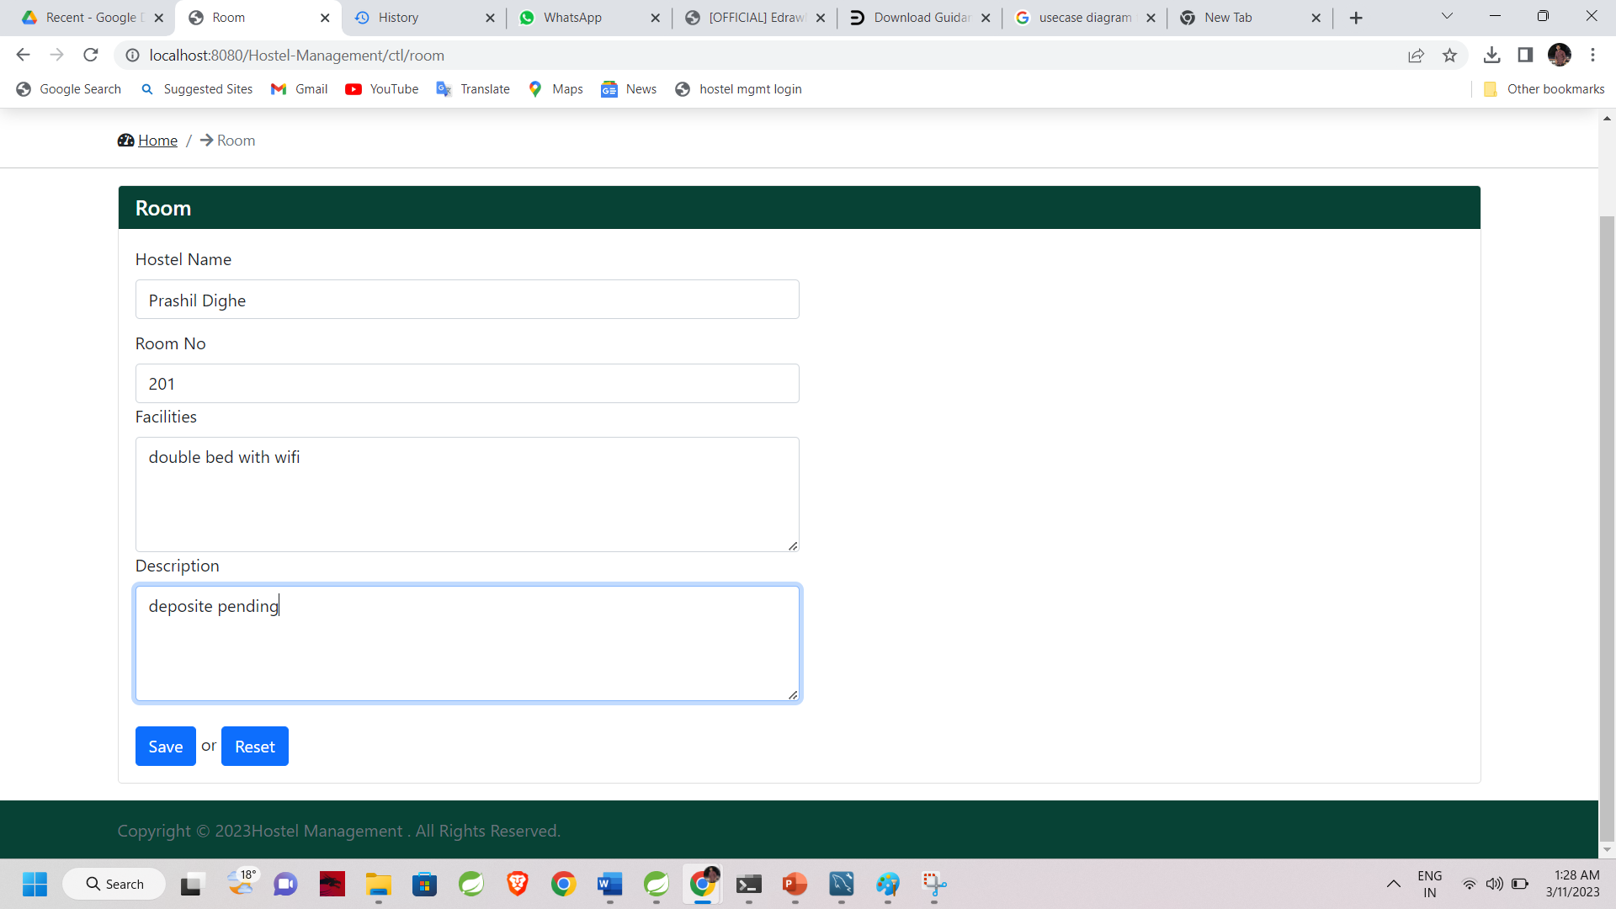

Slide 30
